Slide 1

WAY TO ENTERPRISE
Java Basics
VTI ACADEMY
Author: duy.nguyenngoc1@vti.com.vn
March 2020

Slide 2
Agenda
Internationalization
Annotations
Inner class
Garbage Collector
Java structure
Interview
Assignments
Copyright © VTI Academy All Rights Reserved

Slide 3
Internationalization
I18N
Support language & format number, money, … base on Locale
NumberFormat
DateFormat

Slide 4
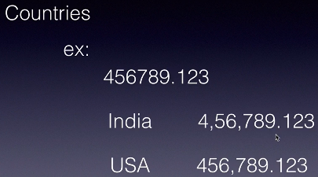
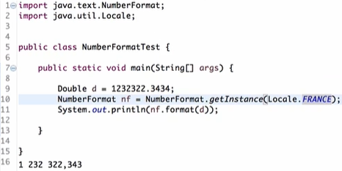
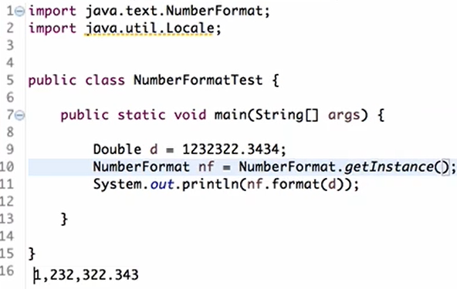
NumberFormat

Slide 5
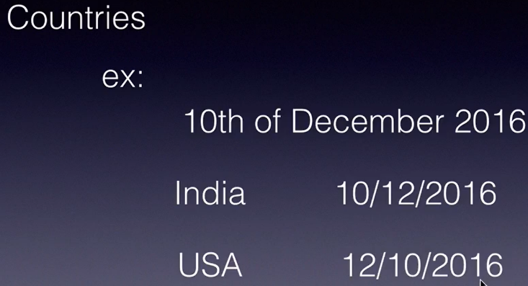
DateFormat
DateFormat
SimpleDateFormat

Slide 6
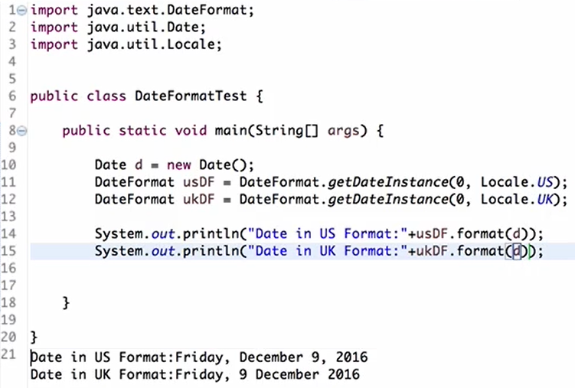
DateFormat

Slide 7
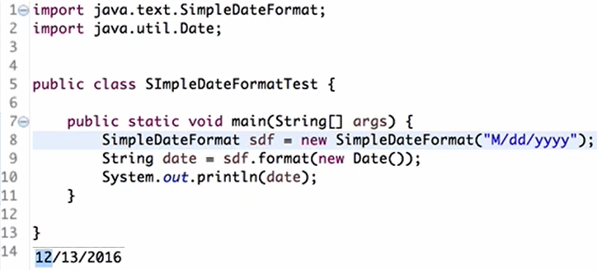
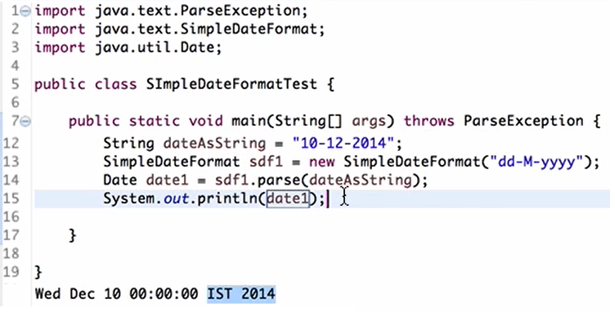
SimpleDateFormat
Convert Date → String
Convert String → Date

Slide 8
Annotations
@Override
@Deprecated
@SuppressWarnings

Slide 9
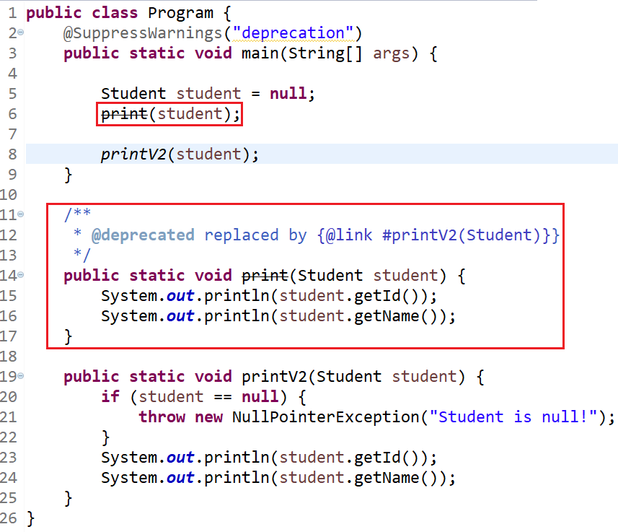
@Deprecated

Slide 10
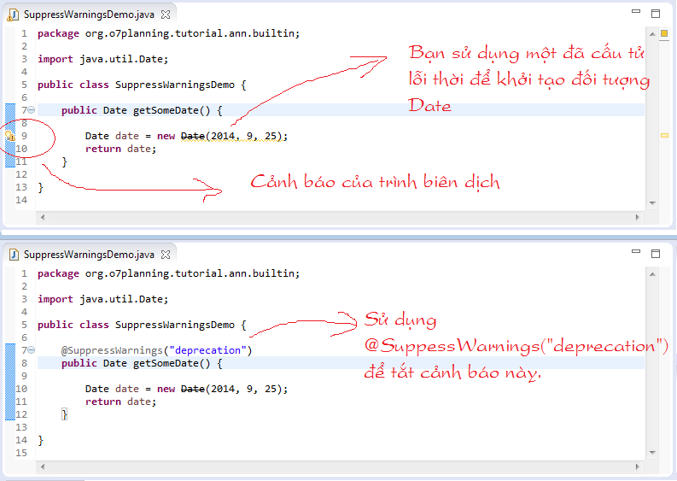
@SuppressWarnings

Slide 11
Inner class
Static & non-static, final, access modifier, inheritance, polymorphism, … similar to Class
Type
Object
Method
Notes:
Khi nào dùng: khi chỉ có class đó sử dụng inner class ➔ tăng tính encapsulation

Slide 12
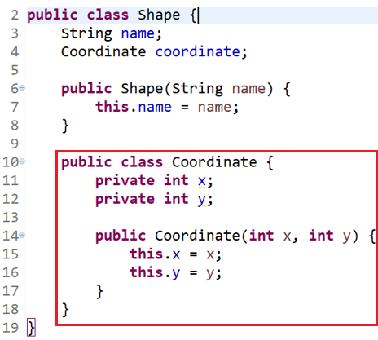
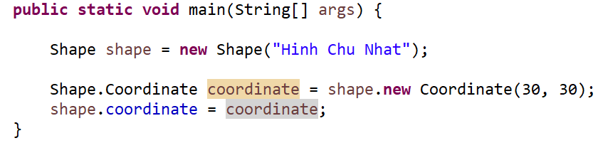
Inner class (Object)

Slide 13
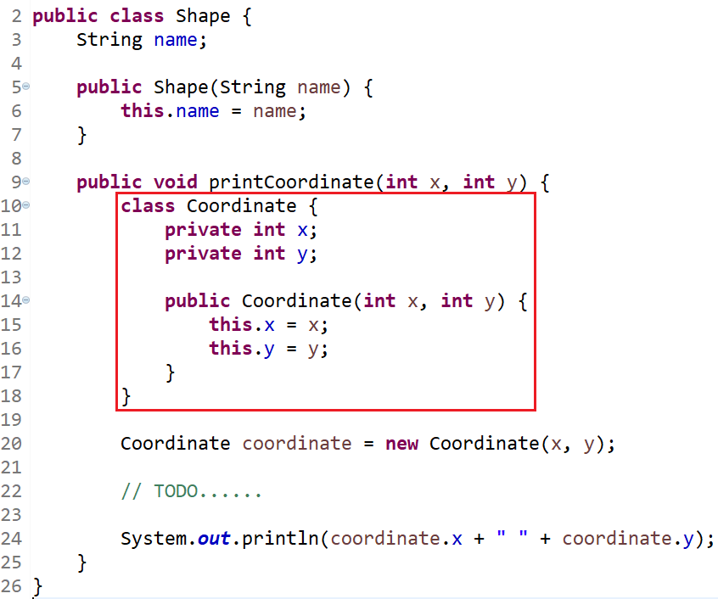
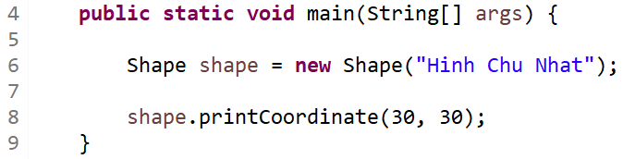
Inner class (Method)

Slide 14
Garbage Collector
Collect "Garbage"
Garbage is
Object has null pointer
Parent of object has null pointer
Local variable

Slide 15
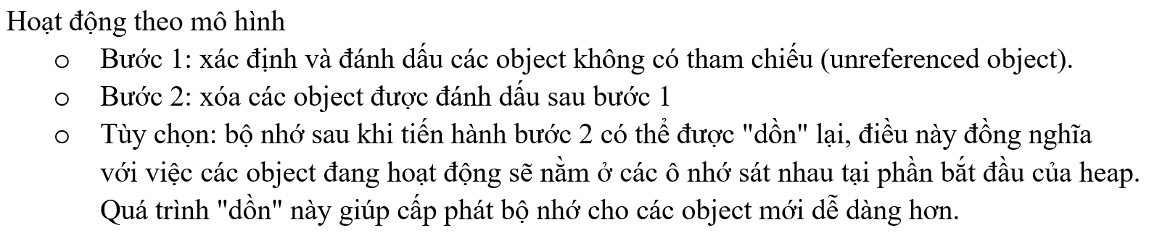
Garbage Collector

Slide 16
Garbage Collector
Methods
System.gc()
finalize()

Slide 17
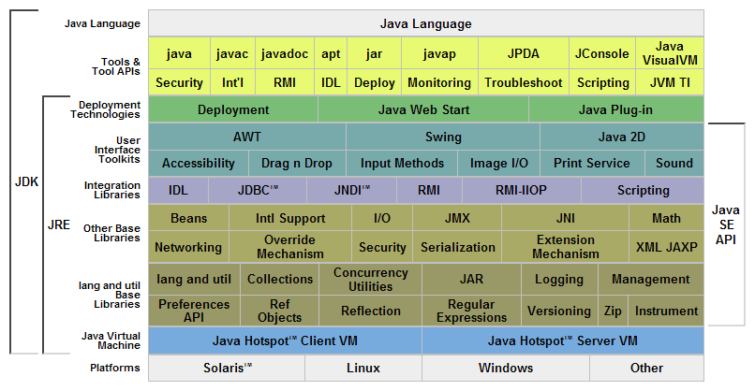
Java Structure

Slide 18
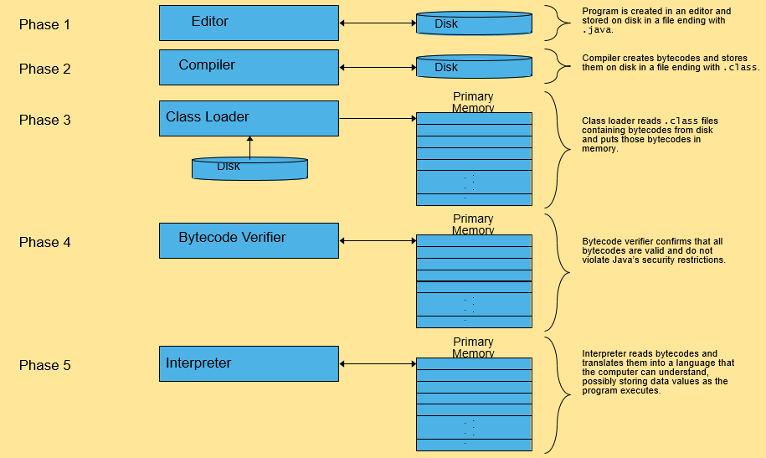
JVM

Slide 19
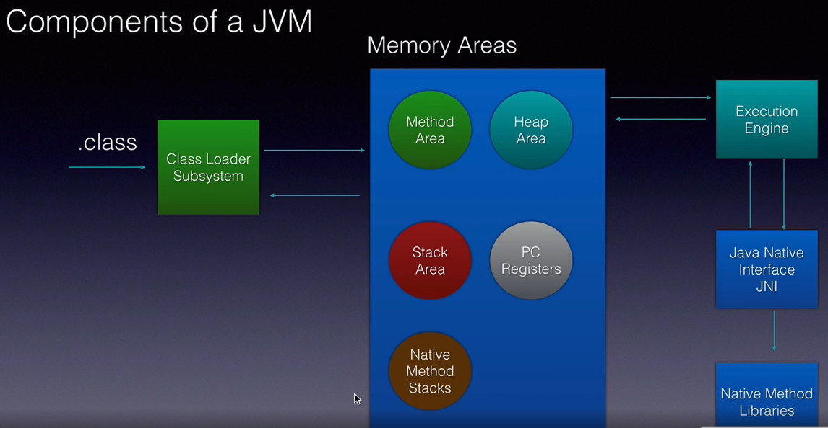
Memory

Slide 20
Interview
Interpretion & Compilation
Runtime & CompileTime

Slide 21
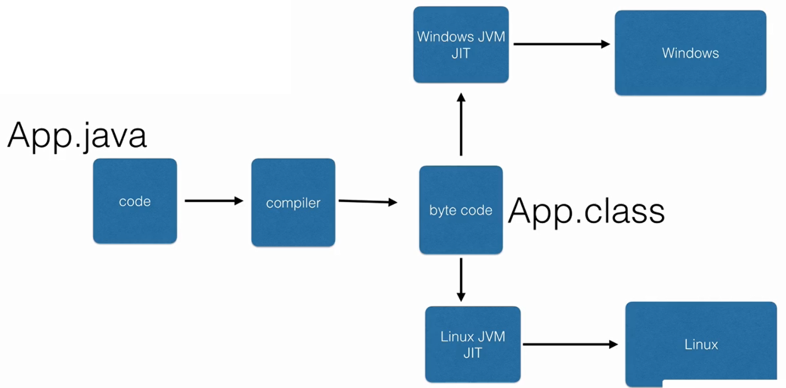
Interpretion & Compilation
Interpretion (Thông dịch)
Compilation (Biên dịch)

Slide 22
Assignments 1

Slide 23
Assignments 2
Assignment for Testing System

Slide 24
Q & A
Copyright © VTI Academy All Rights Reserved

